Slide 1
Common links
Access to common links for Warragul Regional College
https://studenthome.wrc.vic.edu.au is a dashboard that students have access to from school and home with links to the I.T knowledge base, compass, canvas, etc.
Other important links can be found under the star on compass

Slide 2
Account’s
All student’s have two account a Warragul Regional College (WRC) account and a DET account (EduPass @schools)
Your WRC username will be the first 3 letters of your last name + 4 numbers.
For example, if your last name was smith your username may be SMI0001
Your WRC email address would be SMI0001@wrc.vic.edu.au
Your WRC account gives you access to
Microsoft 365 (Office, OneDrive) username: is your wrc email address
Compass username: is your username and not your email address
Canvas username: is your wrc email address
ClickView username: is your wrc email address
School Network (Internet, Printer’s) username: is your username and not your email address
I.T support ticket username: is your username and not your email address

Slide 3
DET account (EduPass @schools)
All students in Victorian State Government schools also receive a centrally managed government "@schools" account.
This account is known as eduPass and gives students access to a range of applications and services from the department of education.
Your DET account gives you access to
• Minecraft for Education - Minecraft for use in schools
• Adobe Suite - Photoshop, Premiere Pro, Lightroom, Etc.
• Education Perfect - Science Curriculum Content
• Khan Academy - Various Online Courses
• Fuse - Victorian Curriculum Content
Accessing EduPass
Once you have your WRC account login details You can retrieve your eduPass login credentials by visiting and logging in with your WRC credentials. By going to https://studenthome.wrc.vic.edu.au/ and clicking on
After retrieving your email / username and password you can access your account at https://edupassmyaccount.education.vic.gov.au/ Links to an external site.
If you have forgotten your password, contact the WRC IT office.

Slide 4
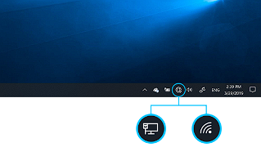
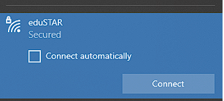
Internet Access
To access the internet at WRC, you will need to be connected to our wireless network. The credentials to login to the wireless network will be your WRC username and password and the network name will be eduSTAR. If you are not connected, click the network icon on your taskbar:
Choose the eduSTAR network:
Mac / MacBook devices Mac devices will connect to our wireless, however, due to default settings the internet will not work. To make the internet work on your Mac device while at WRC, you will need to change the proxy settings:
Go to the Apple menu > System Preferences, click Network
Select eduSTAR from the list on the left, click Advanced, then click Proxies.
Ensure Auto Proxy Discovery is ticked & enabled.

Slide 5
Printing
To access printers on your Device you will need to manually add the PaperCut virtual print queues via "Mobility Print".
Go to https://studenthome.wrc.vic.edu.au/ click on and follow instructions to install
Releasing Prints
Once you have created and sent your print to the virtual follow-me queue, you will need to physically release the job at a printer/copier.
To do so, you will need to login to the copier.
Compass Card
Once you have been issued a Compass© card you can use this to authenticate and login.
You can also use your WRC account to authenticate and login
If you are having any issues please contact the I.T department

Slide 6
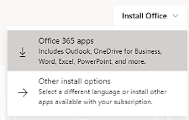
Software
Microsoft 365 (Office, OneDrive)
All WRC students can access the Microsoft Office 365 Suite of word processing applications for free.
This includes Word, Excel, PowerPoint, Outlook, and many others.
To access these applications, simply visit site. And sign in with your WRC email address credentials.
You may also install the applications on your computer instead of using them via the web browser.
On the front page of site. Select the option to download 365 apps:

Slide 7
Like office, students can also access a number of applications from the Adobe Suite.
To do so, you will need to download and install the Adobe Creative Cloud app and sign in with your DET email address credentials. link to Adobe CC on the student dashboard
You can choose which Adobe applications you would like on your computer by clicking install via the All apps page:
Teams is used for conducting classes or hosting meetings remotely. sign in with your WRC email address credentials If you are missing Teams, you can either use the web-browser based version like with other office products or download it link on the student dashboard
ClickView is a video archive website containing over 1000 educational videos and resources for learning and teaching. link on the student dashboard
and sign in with your WRC email address credentials.

Slide 8
Saving your files
Once you have your WRC login credentials and have connected to the school network
You can now sign into Microsoft OneDrive and sync your Documents, Pictures, and Desktop to Microsoft OneDrive (Cloud storage)
OneDrive offers a significant advantage: the ability to edit and share your files seamlessly across all your devices, no matter where you are.By setting up OneDrive backup if your device fails and needs to be wiped your files will be in the cloud and are recoverable
To setup OneDrive to back up your files in folder’s Documents, Pictures, and Desktop please go to the I.T knowledge Base link on the Student Dashboard and click on How To then find the article
Back up your folders with OneDrive

